Slide 1
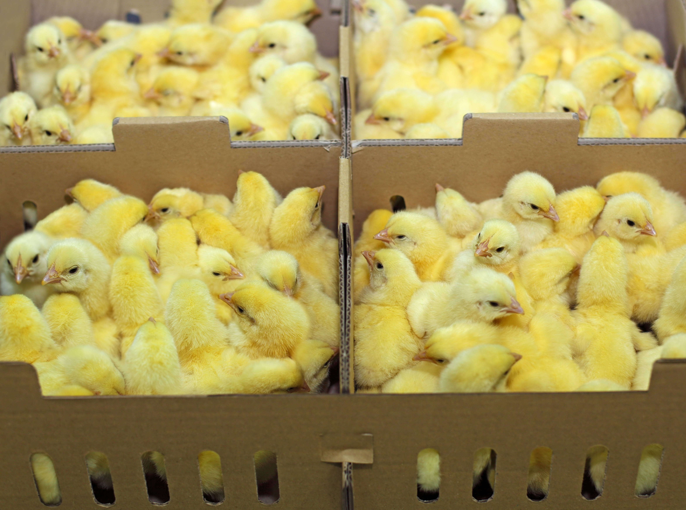
PipShield: Hatcher Microbial Solution

Slide 2

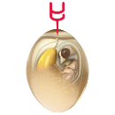






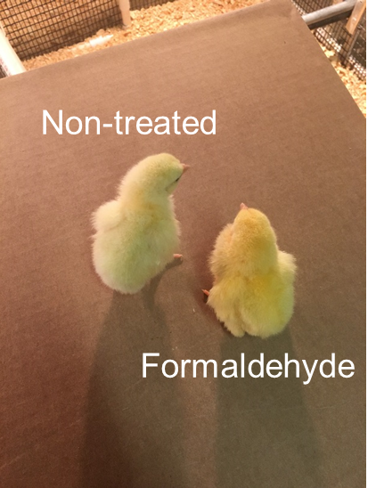
The Hatching process |Harsh chemicals are routinely used to manage pathogenic blooms in hatcheries
HATCHERY
GROW-OUT
PROCESSING
Incubation
18 days
In-ovo vaccination
hours
Hatch
3 days
Segmentation & spray vaccine
hours
35-42 days
1 day
Transport
Transport
Today
The Hatch process is contaminated with high levels of pathogens (from bad eggs) which is managed with Formaldehyde or Peroxide that is sprayed on the eggs/chicks every 4 hours
The problem
Formaldehyde/Peroxide are harsh chemicals that have negative impact on both workers safety and animal welfare
The chemicals also pose a risk to chick liveability and weight gain

Slide 3
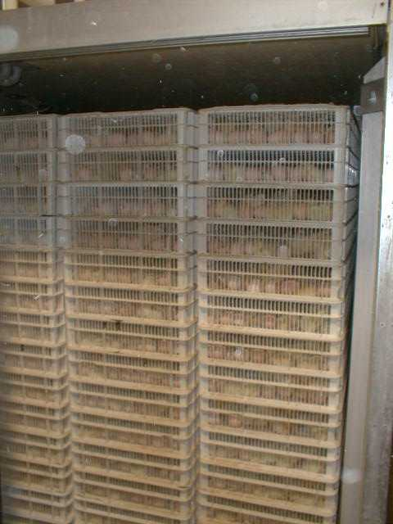
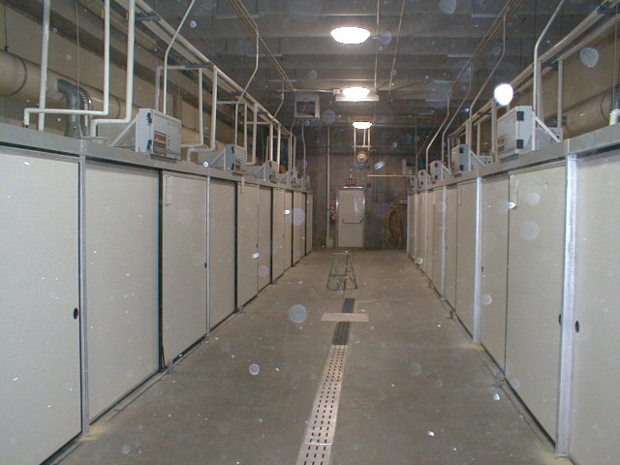
AH007
Hatchery Pictures
Hatcher Hall
Hatcher

Slide 4
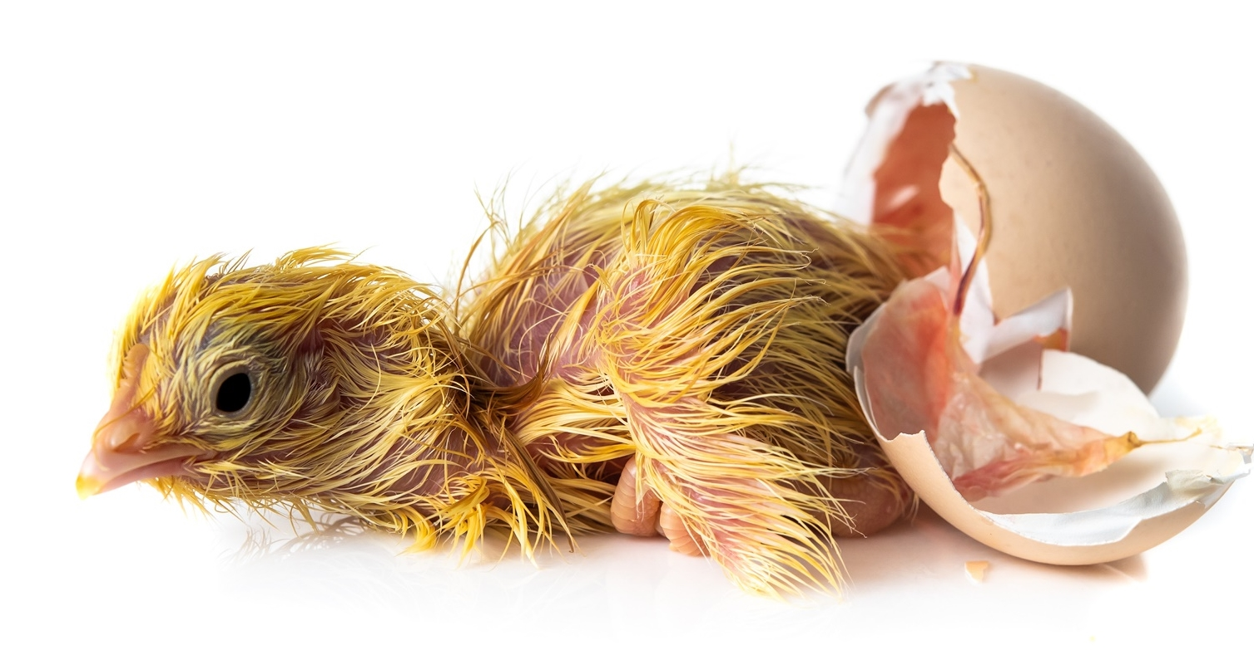
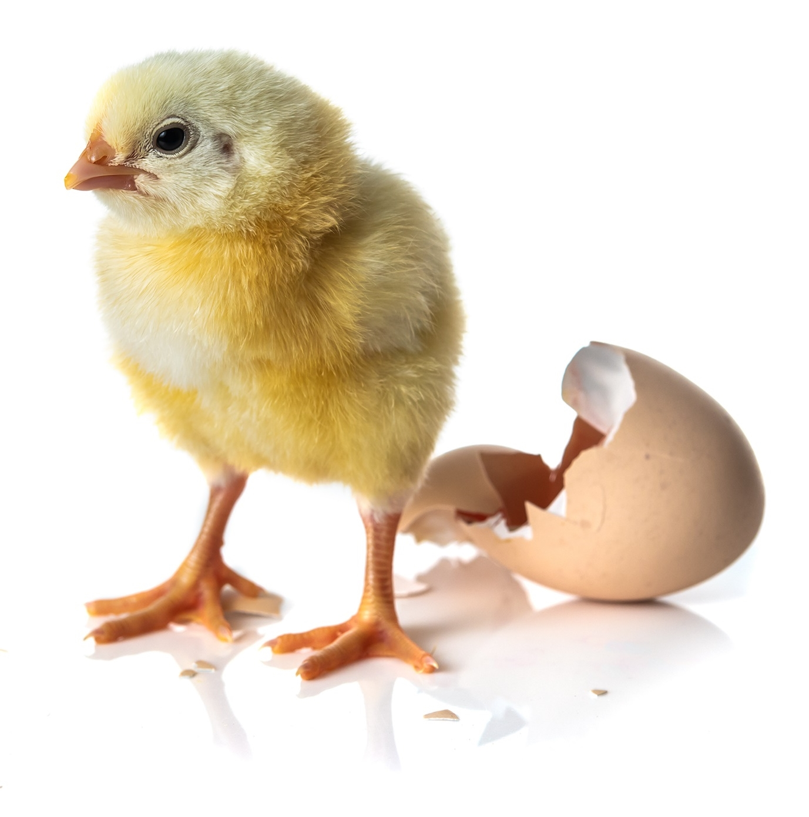
KEY HATCHERY PAIN POINT: MICROBIAL BLOOM
Hatchery ideal environment for microbial contamination (i.e., microbial bloom)
Large number of microbes on egg surface
Hatchery bloom contributes to:
Reduced hatch rates
Warm temps and humidity promote microbial growth
Early chick exposure to potentially pathogenic bacteria
Coliforms
Staphylococcus
Salmonella
2-4 h
4

Slide 5

The solution
Hatch management with Live Biotherapeutics
PipShield
Bacillus
Lactic acid bacteria
Benefits
Environmental pathogen inhibition
Control hatchery bloom without use of formaldehyde
Benefits
Early Gut Colonization
Pathogen inhibition in GIT
Increased body weight gain
PipShield is a blend of beneficial bacteria administered via a dry spray that allows producers to manage the bacterial bloom during hatch while providing early colonization of Lactic acid bacteria in GIT – without the use of Formaldehyde or other harsh chemicals

Slide 6
A two-pronged approach to hatch bloom management
Bacillus (Bacillus.amyloliquefaciens)
Environmental pathogen control
Control of hatchery bloom without use of Formaldehyde
Lactic Acid Bacteria (Pediococcus acidilactici)
Early gut colonization
Pathogen inhibition in the GIT
Increase BWG
1.
Management of microbial bloom on par with Formaldehyde
2.
BWG of 3-5% compared to Formaldehyde at day 7
BWG at D7 post hatch (grams)
+4%
Negative control
Formaldehyde
PipShield
BWG at D7 post hatch in challenge model (grams)
-4%
+4%
Negative control
Challenge
Challenge +
Formaldehyde
Challenge +
PipShield

Slide 7
Five Years of Research and Development
Hundreds of individual bacterial isolates were screened for pathogen inhibition, GIT survival, rapid growth in hatchery conditions, etc
Fifteen isolates were selected and screened for their effect on common hatchery bacteria and their effect on bird performance (5 trials)
Nine combinations were evaluated in small scale hatcher studies for effect on hatch bloom and D7 and D10 bird performance (12 trials)
Three combinations were evaluated in floor pen grow out studies (7 trials)
Dose response trials were conducted for one combination (9 trials; combination of total dose and varying doses of each isolate)
Final combination and dose was evaluated in Challenge trials (APEC, Salmonella, Enterococcus) and Mechanism of Action studies (leaky gut, inflammation markers, tracheal cilia activity) (12 studies)
Pacific Vet Group
&
Novozymes
PipShield
Auburn University
&
Ozark Avian Research
University of Arkansas

Slide 8
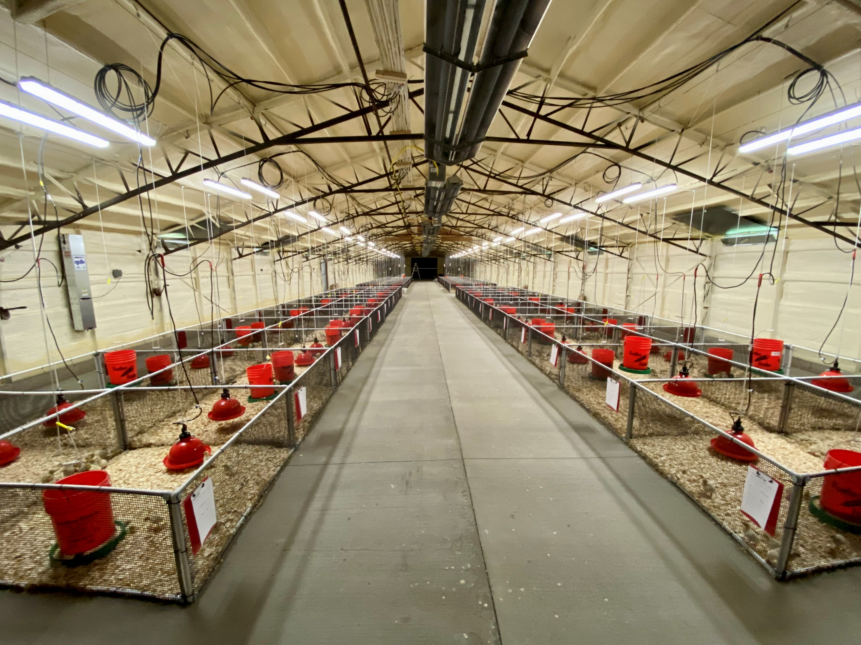
Five Years of Research and Development
Ozark Avian Research
96 pen; 2400 bird facility near Fayetteville, Arkansas
Battery systems for MOA and POC studies
Owned and operated by 2 PhD nutritionists and 1 DVM Poultry Vet
Contracted by Tyson, Dupont, BASF, ZinPro, & Ancera
Research partnership with University of Arkansas

Slide 9
Commercial Paired house trials: 1.5M Bird
Split contract farms of 6 or 8 houses
Breeder flocks were mixed at transfer to ensure uniformity

Slide 10
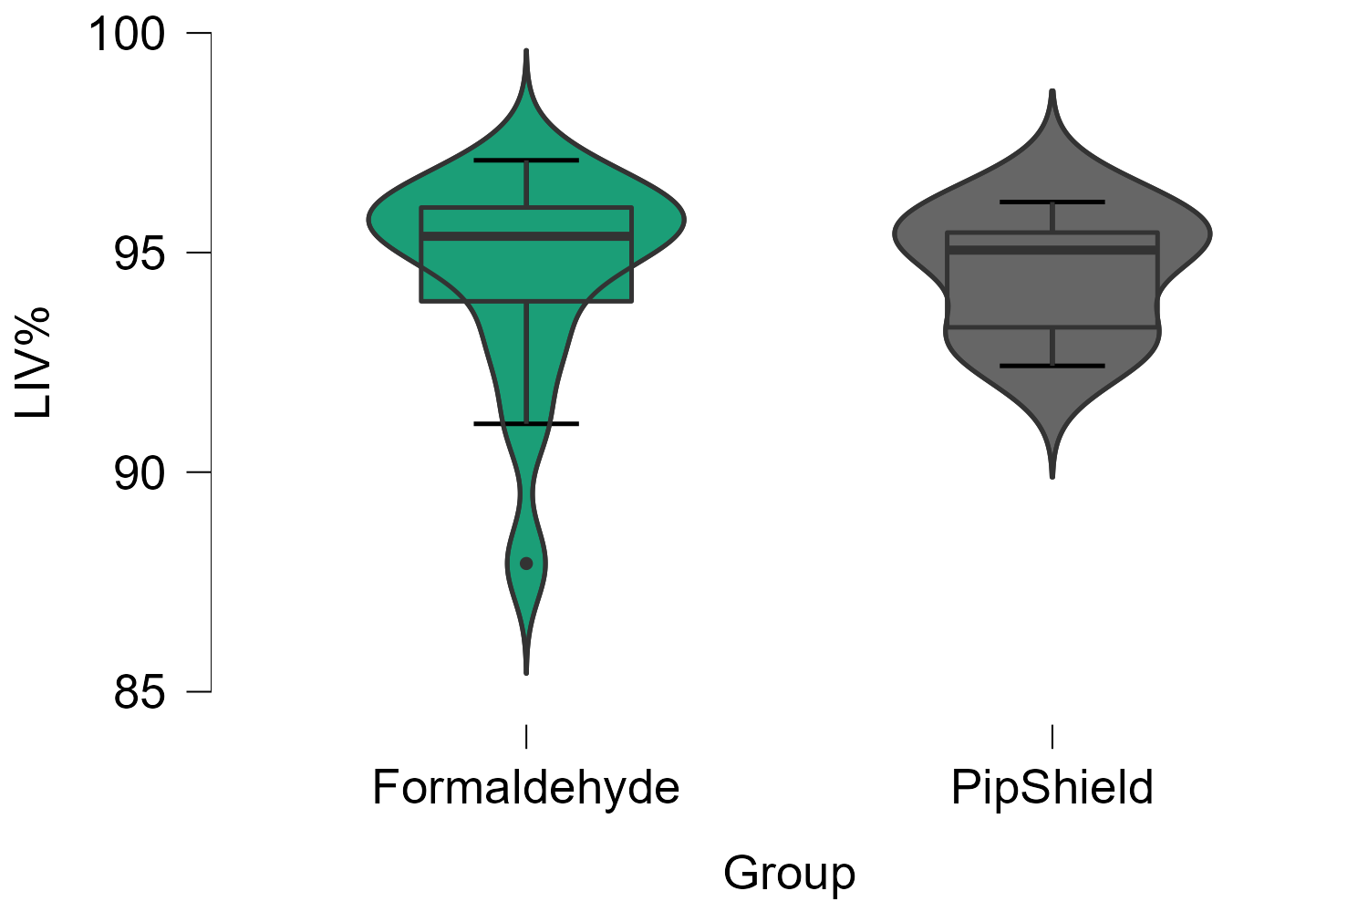
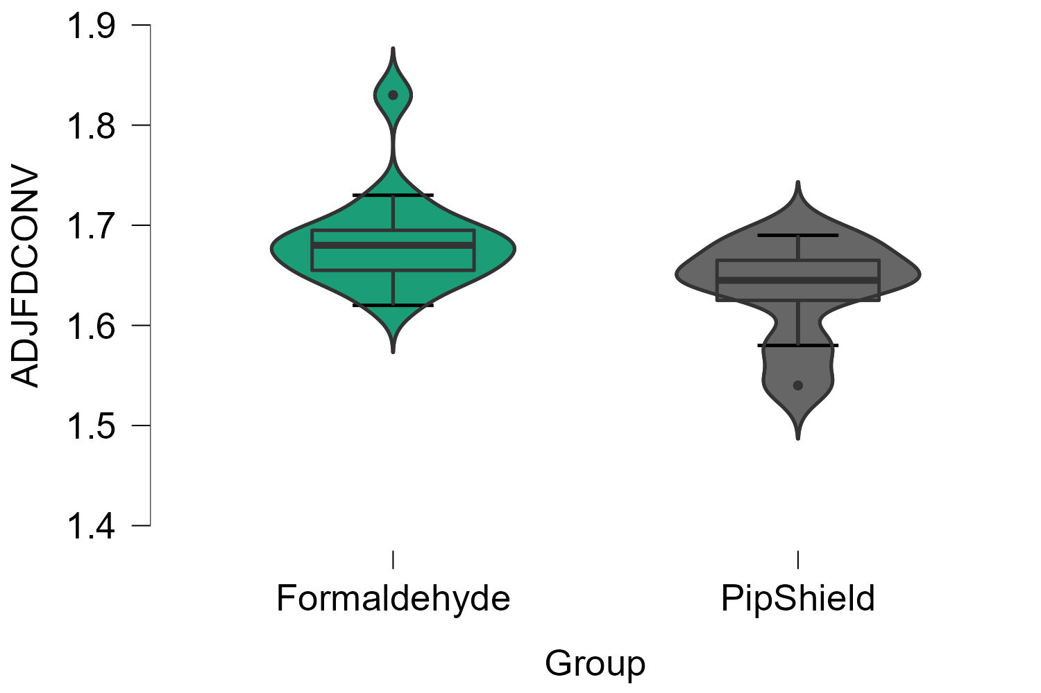
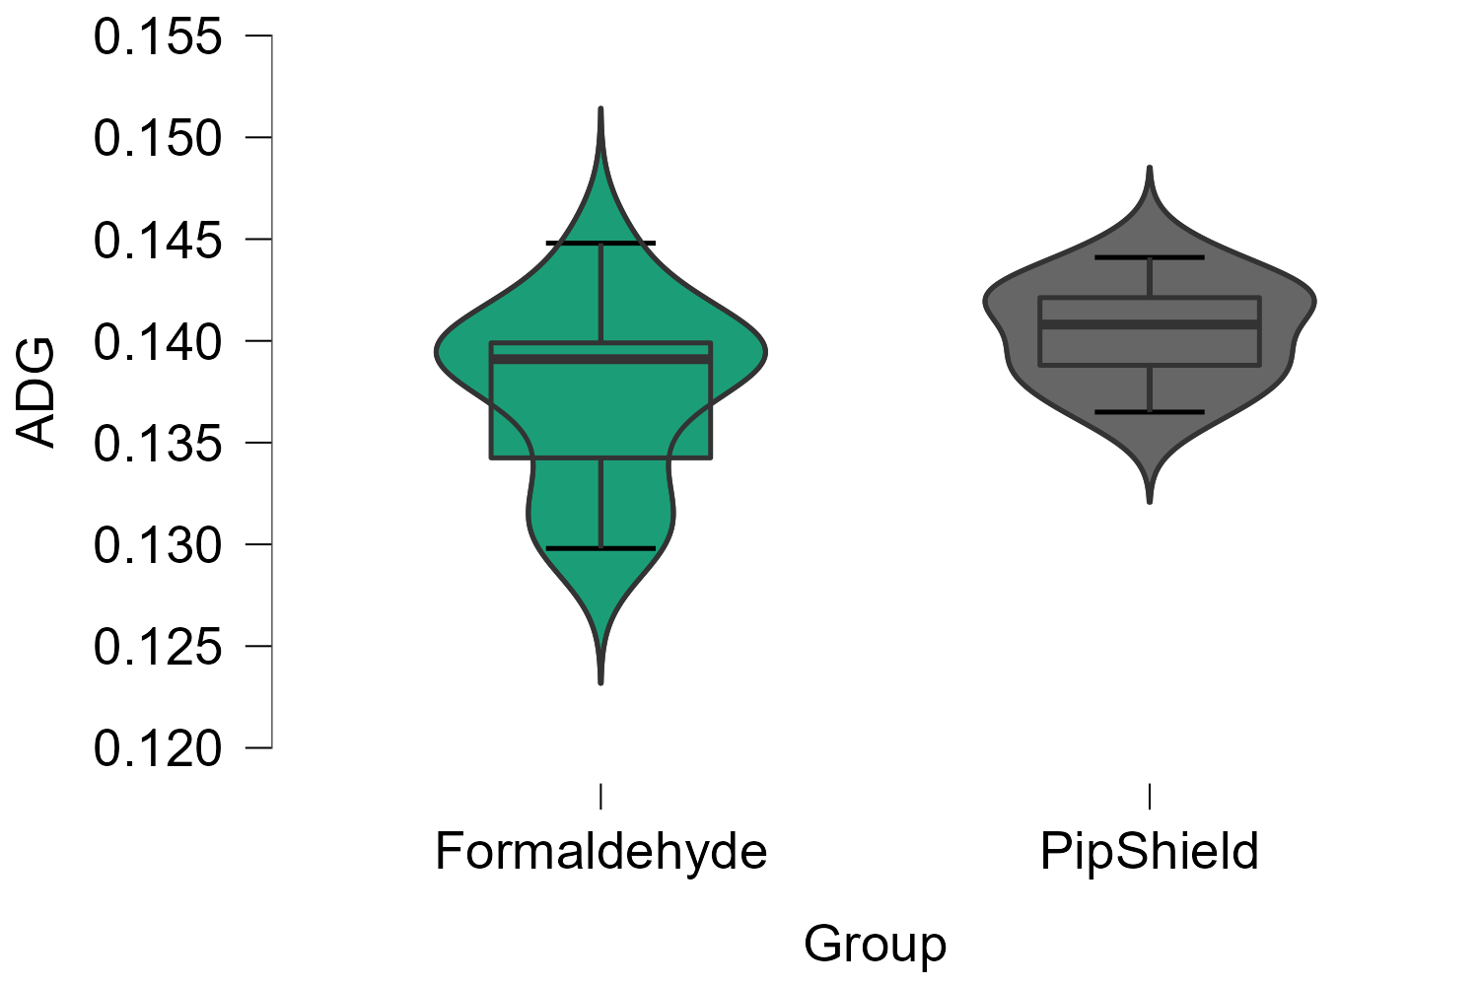
3.5M bird commercial trial
 | Formaldehyde | PipShield
AdjFCR | 1.68 | 1.63
ADG | 0.137 | 0.140
Livability % | 94.55 | 94.56

Slide 11
Commercial 1M bird trial: Split contract Farms
Split 12 or 14 house farms
4.25 pt of FCR
0.27 lb (.123 kg) LW

Slide 12
Commercial D7 weights
Improvement in D7 weights likely due to reduced inflammation from development of a positive microbiome and no of exposure to mucous membrane irritants
No Treatment
PipShield
Peroxide
Formalin
PipShield
Formalin
PipShield
Formalin
PipShield

Slide 13
Commercial D7 Mortality
PipShield may change mortality curves
Formaldehyde allows omphalitis birds to “limp” along longer
  We see these birds die earlier
PipShield reduces the number of “leaky gut” related mortalities later in life
Purple: No Treatment Blue: Formaldehyde
Green: PipShield Yellow: Peroxide

Slide 14
PipShield Mortality
Omphalitis associated mortality
Leaky gut associated mortality

Slide 15
Enterococcus reduction in the Hatcher
A Coriolis machine was used to measure the bacterial load of 1 liter of hatcher air at different hatch times. CHROMagar was used to identify Enterococcus species.

Slide 16
Enterococcus reduction in the Bird
Gastrointestinal tracts of Day of Hatch chicks were collected and evaluated for Enterococcus
Farms C and F had high mortality due to Enterococcus septicemia. PipShield greatly reduced mortality due to hatchery-associated septicemia

Slide 17
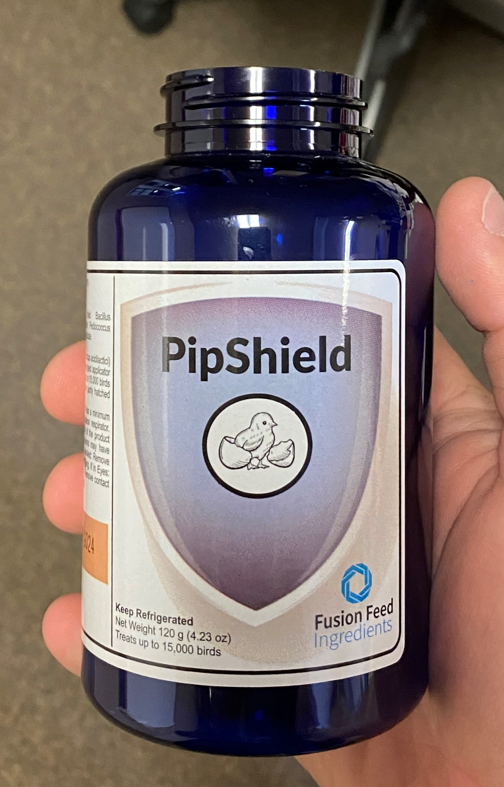
Application
Applied as a dry powder spray in the hatcher at transfer, 20%, 50%, and 80% hatch
  One bottle of PipShield treats 15k eggs and contains all four doses
Automated and can be set up as a standalone control system or integrated into the central hatchery controls
Applicator requires access to central compressed air
  Only moving parts are a single air solenoid per applicator
  Installation and service schedule
Hatcheries with good C&D programs will gain the best results
  Dirty and poor performing hatcheries need the Band-Aid of formaldehyde
45 University and CRO Studies
&
>10M Bird Commercial Studies

